Slide 1
Oct 11-13, 2006
R. Todd Lines

Slide 2
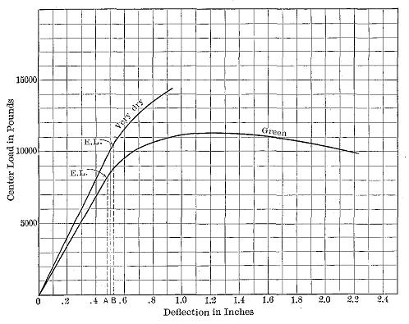
Stress-strain diagrams of two longleaf pine beams. E.L. = elastic limit. The areas of the triangles 0(EL)A and 0(EL)B represent the elastic resilience of the dry and green beams, respectively (Public Domain Image from Samuel J. Record,
The Mechanical Properties of Wood Including a Discussion of the Factors Affecting the Mechanical Properties, and Methods of Timber Testing, http://www.gutenberg.org/ebooks/12299
Stress
Elastic Limit
Breaking
Point
Elastic Region
Strain
Oct 11-13, 2006
R. Todd Lines

Slide 3
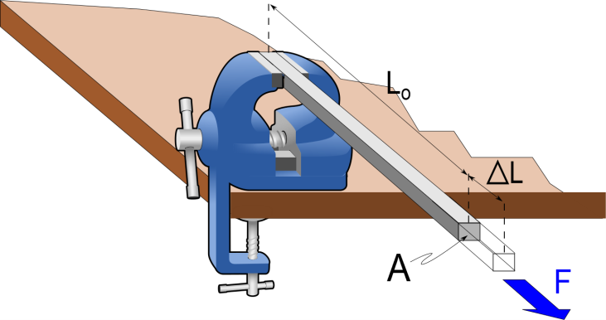
Question 123.7.1
I have two bars made out of different materials. Bar A has a Young’s modulus that is half that of bar B. I apply a force F to each bar. Which bar stretches more?
  Bar A
  Bar B
  They stretch the same

Slide 4
Question 123.7.1
I have two bars made out of different materials. Bar A has a Young’s modulus that is half that of bar B. I apply a force F to each bar. Which bar stretches more?
  Bar A
  Bar B
  They stretch the same

Slide 5


Oct 11-13, 2006
R. Todd Lines

Slide 6
Material | Young’s Modulus (N/m^2)
Aluminum | 7 x 10¹⁰
Titanium | 11 x 10¹⁰
Steel | 20 x 10¹⁰
Carbon Steel | 21 x 10¹⁰
Lead | 1.6 x 10¹⁰
Brass | 10 x 10¹⁰
Concrete | 2.0 x 10¹⁰
Nylon | 0.5 x 10¹⁰
Bone (arm more leg) | 1.5 x 10¹⁰
Pine Wood (parallel to grain (perpendicular to grain) | 1.0 x 10¹⁰ 0.1 x 10¹⁰
Oct 11-13, 2006
R. Todd Lines

Slide 7
Problem
Suppose we have a steel piano wire. One end of the piano wire is fixed in place, and the other is connected to a peg that can be rotated so the piano wire is tightened so that there will be 980N of tension on the wire. The wire is 1.6m long and has a diameter of 2mm . How much will the wire stretch as we tighten the peg?
Young's modulus for steel is 20×10¹⁰N /m³.
Oct 11-13, 2006
R. Todd Lines

Slide 8
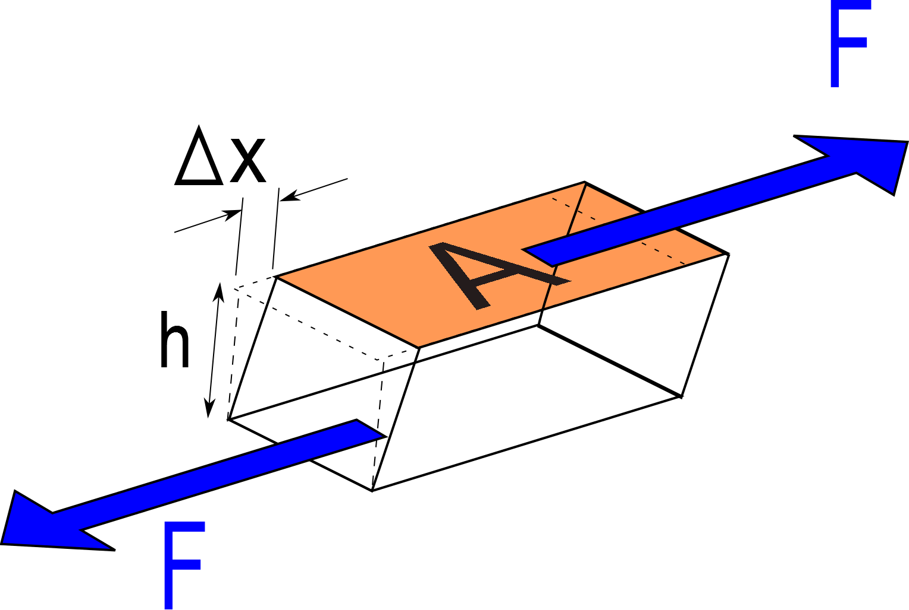
Oct 11-13, 2006
R. Todd Lines

Slide 9
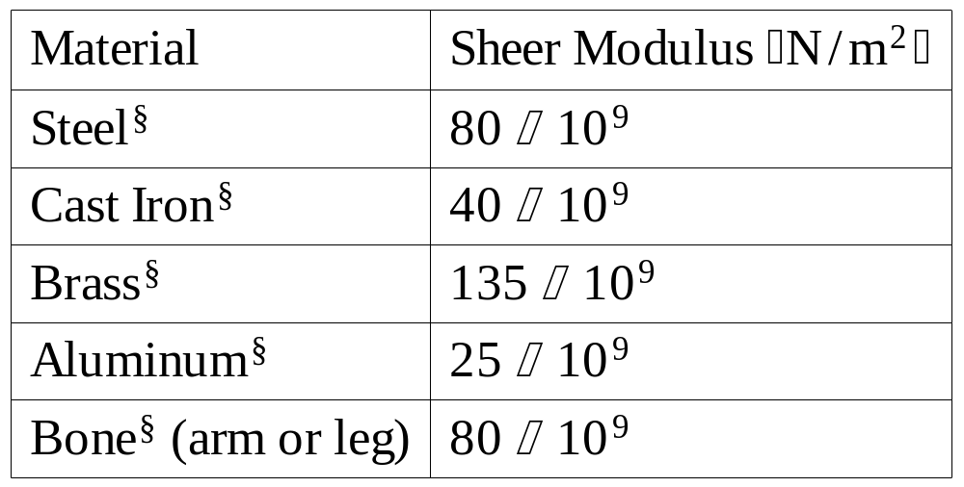
Oct 11-13, 2006
R. Todd Lines

Slide 10
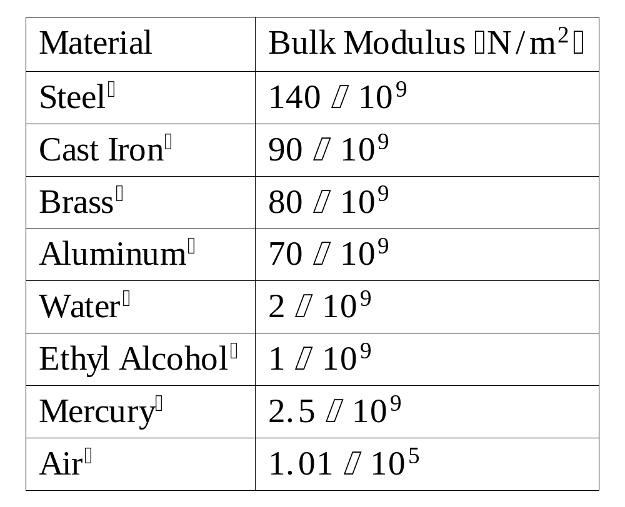

Slide 11
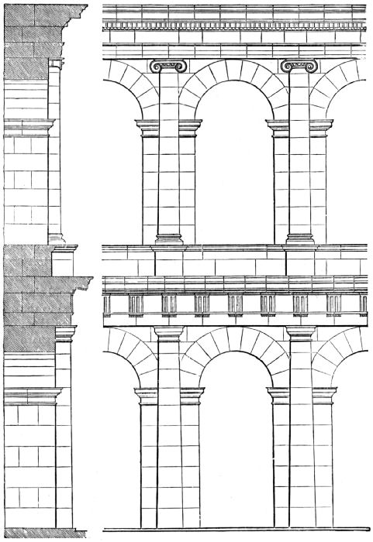
Part of the Theatre of Marcellus, Rome. Thomas Roger Smith John Slater, Architecture Classic and Early Christian, LONDON. PRINTED BY WILLIAM CLOWES AND SONS, LIMITED, 1882
Key Stone
Oct 11-13, 2006
R. Todd Lines

Slide 12
Key Stone
Arch Stone
Force of Building Load
Force of Building Load
Horizontal components of force from arch stones
Horizontal components of force from arch stones
Upward component of force of next arch stone
Upward component of force of arch stones
Oct 11-13, 2006
R. Todd Lines

Slide 13
Part of the Theatre of Marcellus, Rome. Thomas Roger Smith John Slater, Architecture Classic and Early Christian, LONDON. PRINTED BY WILLIAM CLOWES AND SONS, LIMITED, 1882
Buttress Force

Slide 14
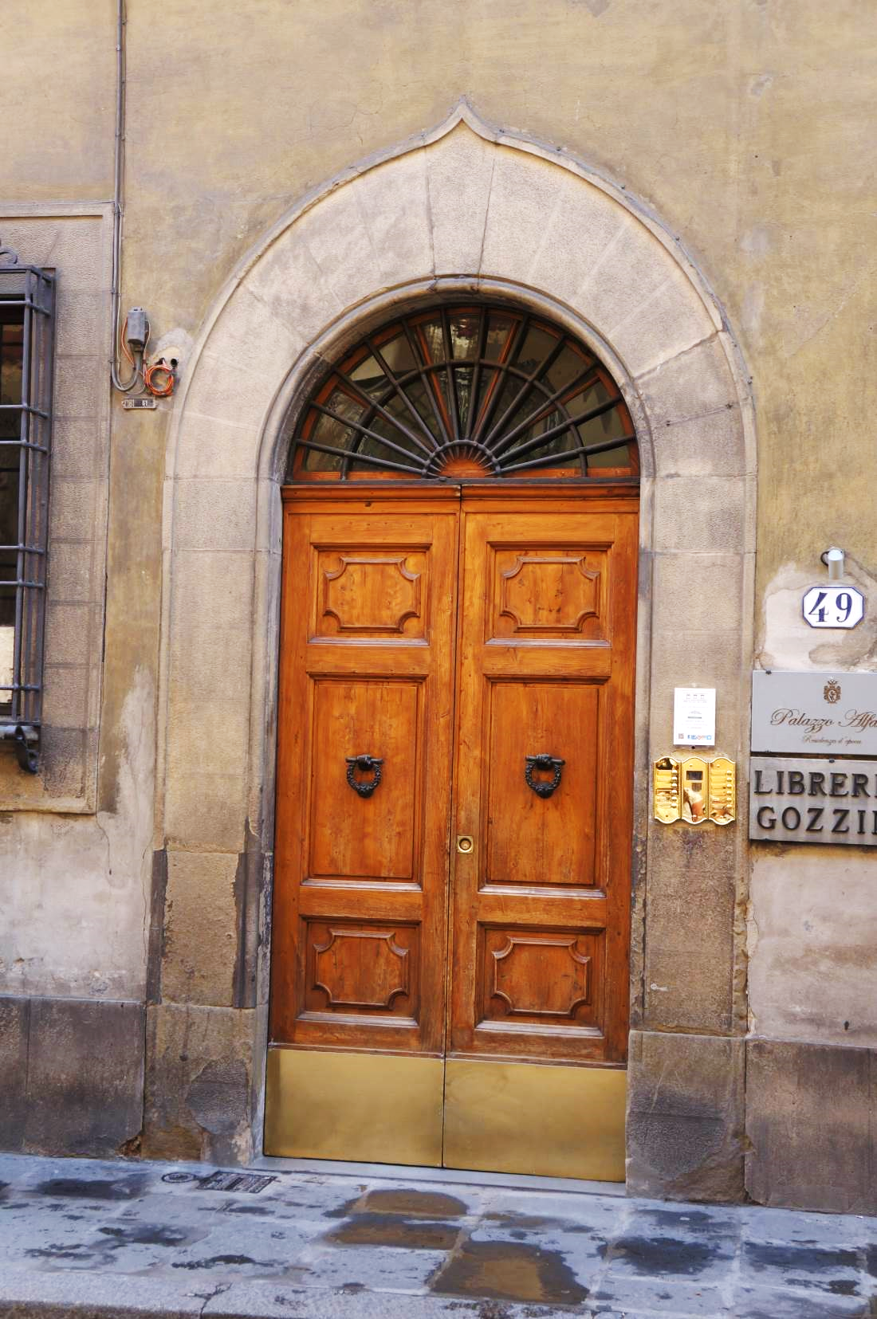

Slide 15
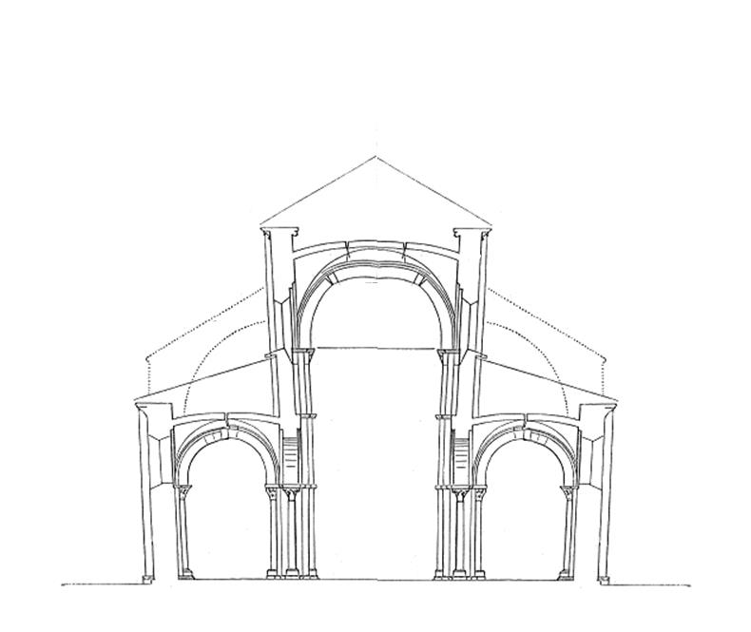
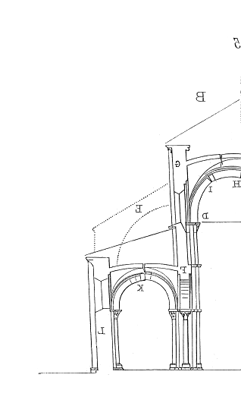
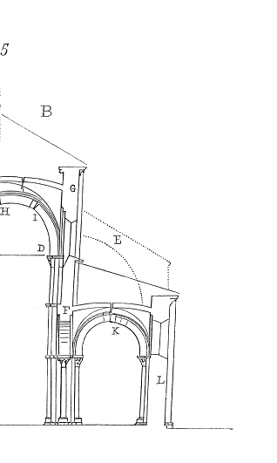
Inner arch creates outward force
Buttress provides opposing force to keep the building in equilibrium

Slide 16
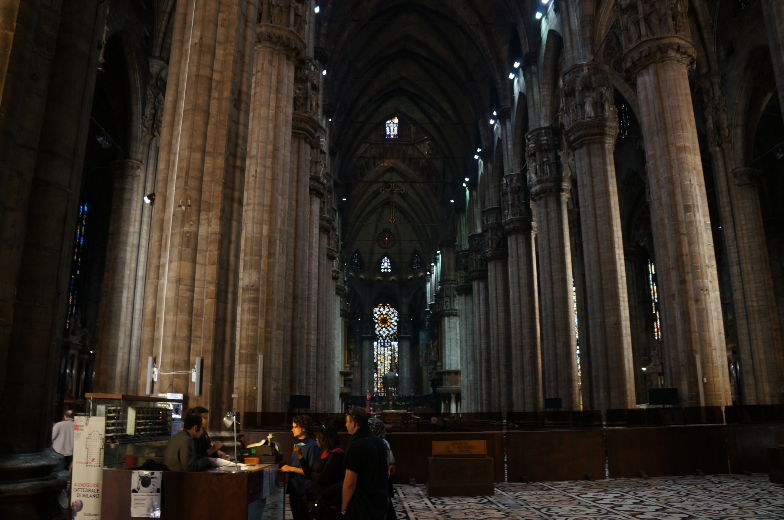

Slide 17
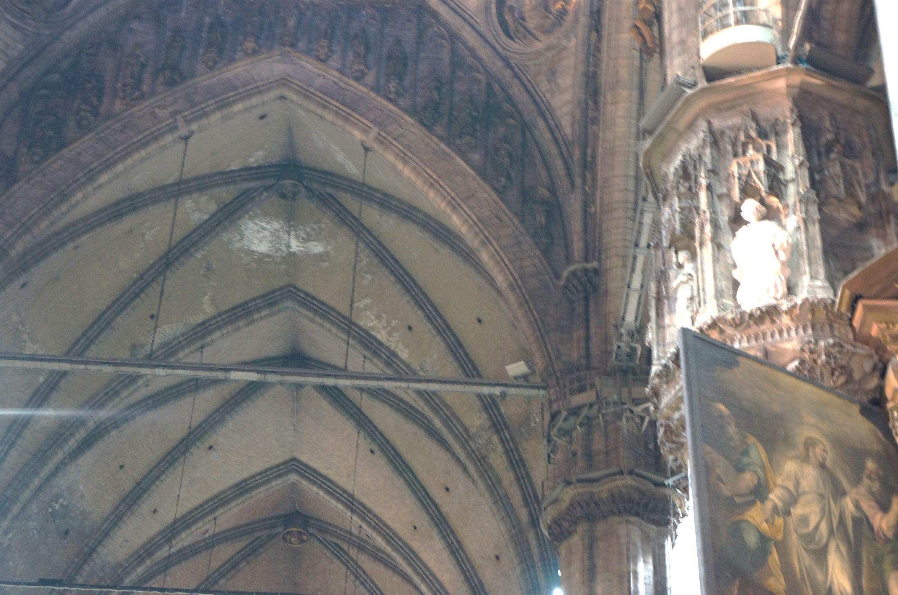
Oct 11-13, 2006
R. Todd Lines

Slide 18
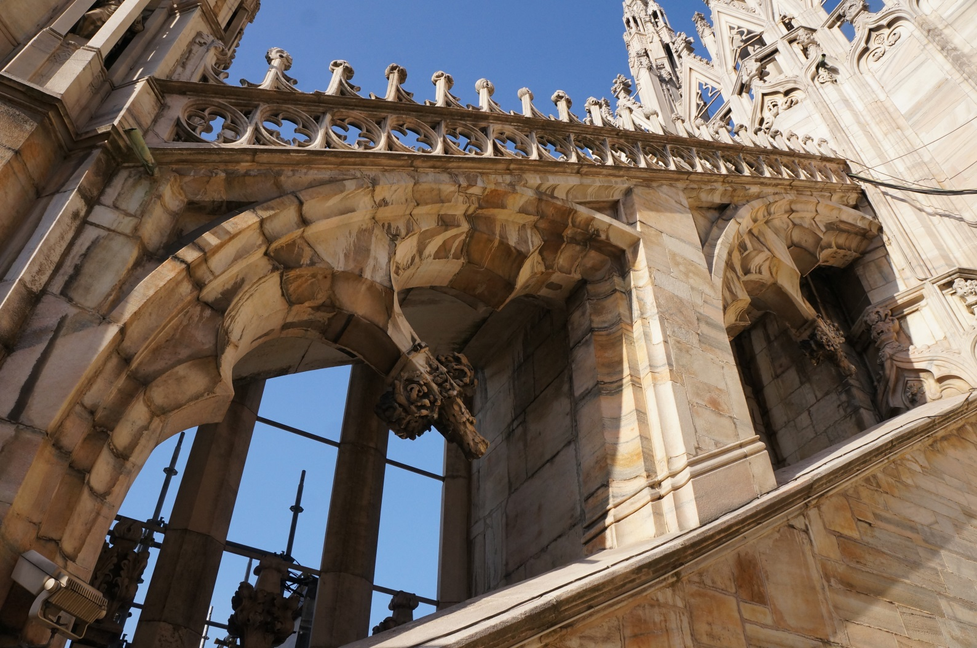
Bottom of Arched Ceiling Ends Here (but you can’t see it because it is inside
Cathedral Wall
Buttress Point for this part of the Wall

Slide 19
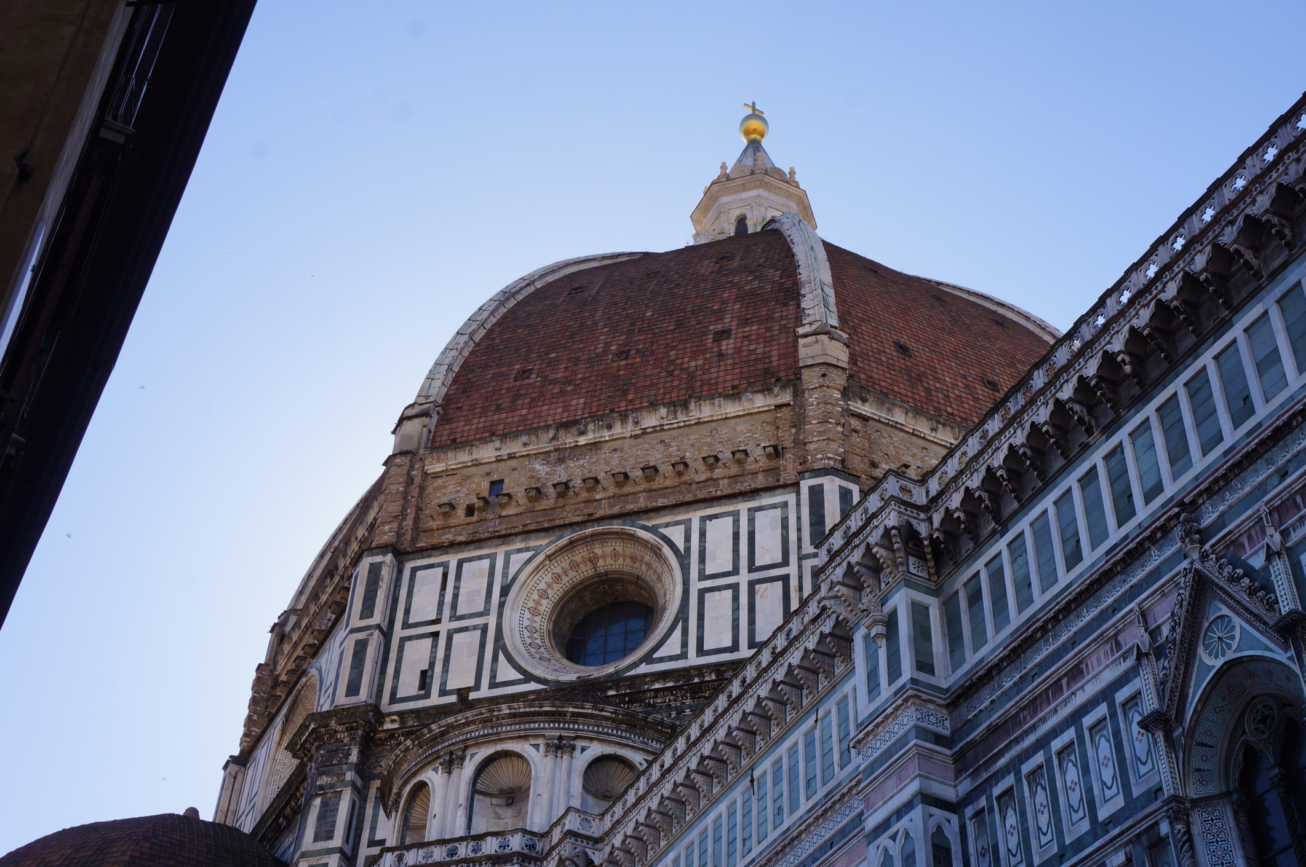
Oct 11-13, 2006
R. Todd Lines

Slide 20
Problem
Suppose we return to our piano wire. If we keep turning the peg, the steel wire will break. How much tension will break the wire?
The ultimate tensile strength for steel is 500×10⁶N /m².
Oct 11-13, 2006
R. Todd Lines

Slide 21
Question 123.7.2
In thermodynamics, what does “phase” mean
It is how shifted the sample is in time
It is how shifted the sample is in position
It is the state of matter, like solid, liquid or gas, that the sample currently has
This word is not used in thermodynamics

Slide 22
Question 123.7.3
Which of the following is a phase change
An orbiting satellite
Compressing a soda can
Deforming Jello by pushing across the top
Melting icecream
Grinding iron to poweder

Slide 23
Question 123.7.4
If two samples of matter are measured to be at the same temperature, what can we say about them.
They must be the same material
They must be the same state of matter
They must be the same phase
They must be in thermal equilibrium

Slide 24
Thermal Contact Defined
A
B

Slide 25
Thermal Contact Defined
A
B

Slide 26
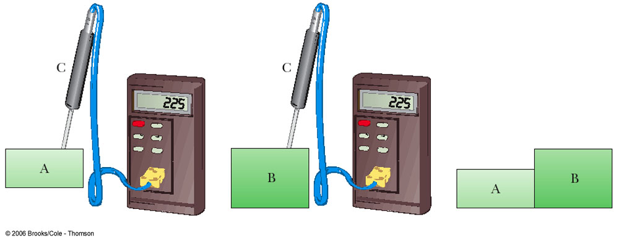
Zeroth Law of Thermodynamics
If objects A and B are separately in thermal equilibrium with a third object, C, then A and B are in thermal equilibrium with each other.
Allows a definition of temperature

Slide 27
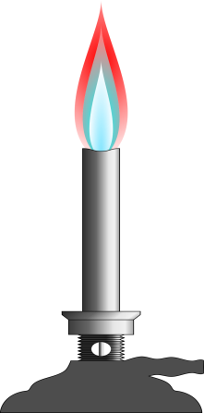
100°C
0°C

Slide 28
Temperature from the Zeroth Law
Two objects in thermal equilibrium with each other are at the same temperature
Temperature is the property that determines whether or not an object is in thermal equilibrium with other objects

Slide 29
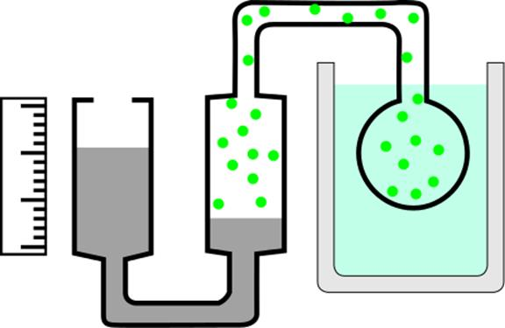
Gas
Fluid at temperature, T
Mercury
Oct 11-13, 2006
R. Todd Lines

Slide 30
P (Pa)
Temperature (°C)
-200
-100
0
100

Slide 31
P (Pa)
P = 0 Pa
T = -273 °C
Temperature (°C)
-200
-100
0
100

Slide 32
P (Pa)
P = 0 Pa
T = 0 K
Temperature (°C)
-200
-100
0
100

Slide 33
10⁹
10⁸
10⁷
Solar Interior
10⁶
10⁵
10⁴
Solar “surface”
10³
Copper Melting Point
10²
Water Freezes
Liquid Nitrogen
10
1
Liquid Helium

